Slide 1
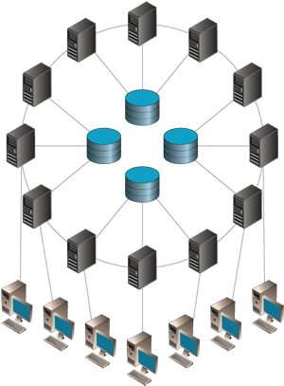
Distributed Systems
Lee Tobin
lee.tobin@griffith.ie

Slide 2
Linux
sudo apt-get install build-essentials libopenmpi-dev openmpi-bin openmpi-doc
Create a hello world file: “hello.cpp”
Compile: mpic++ hello.cpp –o hello
Run: mpiexec hello

Slide 3
Mac
http://brew.sh
In a terminal: brew install open-mpi
Create a hello world file “hello.cpp”
Compile: mpic++ hello.cpp –o hello
Run: mpiexec hello

Slide 4
Windows
Install Visual Studio Express
Install MS-MPI
OR
Use Visual Studio on the lab PCs and use the nu-get package manager to install MS-MPI
OR
Install Cygwin – use the search functionality and install…
gcc-g++, libopenmpi-devel, libopenmpicxx1, openmpi
Compile: mpic++ hello.cpp –o hello
Run: mpiexec hello

